Slide 1
Quantum Machine Learning
[Introduce to quantum ml – 2014]
Vu Tuan Hai

Slide 2
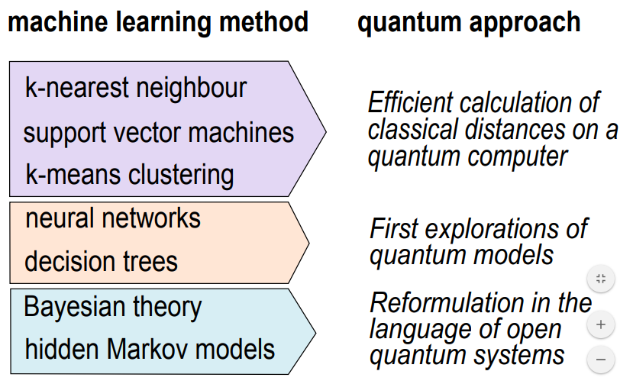

Slide 3
Quantum machine learning

Slide 4
1. Quantum computing

Slide 5
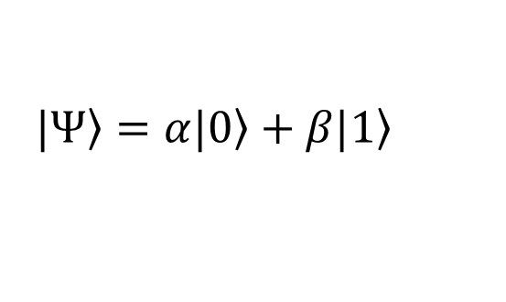
1.1. From single state to superposition
$$\left.|Ψ\right\rangle =α\left.|0\right\rangle +β\left.|1\right\rangle$$

Slide 6
1.2. From certainly to uncertainly
Certain Object: {
position: [],
momentum: []
}

Slide 7
1.3. Spooky action
A or B
A or B
entangled
open
100 % B
A

Slide 9
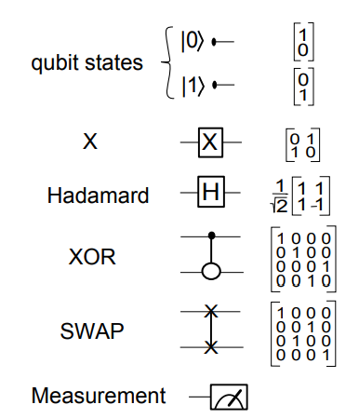

Slide 10
2. Quantum machine learning

Slide 11
Develop entire quantum algorithms to solve new problem

Slide 12
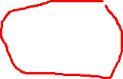
Using the advantages of quantum computing in order to improve machine learning algorithms
Quantum version of neural network (quanvolutional, …)
Speed up machine learning algorithms on quantum computer / simulation
Quantum learning

Slide 13

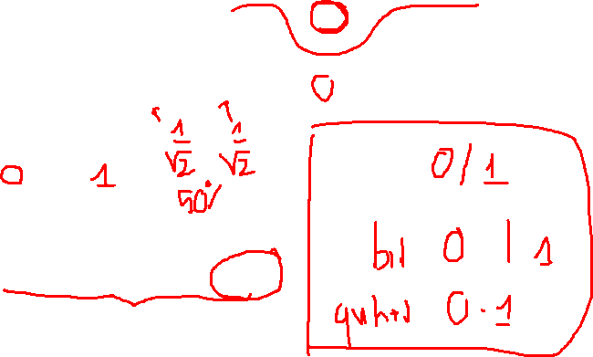
2.1. Qubit
Basic unit: $\left.|Ψ\right\rangle =α\left.|0\right\rangle +β\left.|1\right\rangle$, $α,β∈ℂ;\left.|0\right\rangle$, $\left.|1\right\rangle$ in 2-d Hibert space.
$${|α|}^{2}+{\left|β\right|}^{2}=1$$
$\left.|0\right\rangle =\left[\begin{matrix}1 \\ 0\end{matrix}\right]$, $\left.|1\right\rangle =\left[\begin{matrix}0 \\ 1\end{matrix}\right]$
Excute by ion trapping or photon.

Slide 14

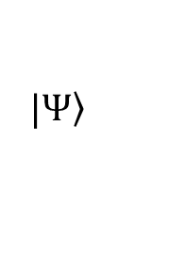
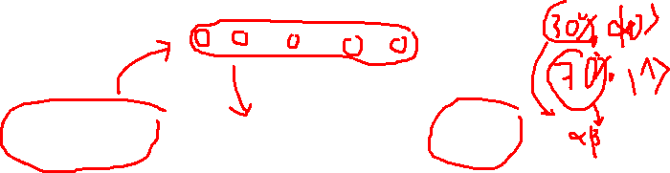
Classical data
00010000…
Quantum gates
Measure
$$\left.|Ψ\right\rangle$$
$$α, β$$
Classical computer

Slide 15
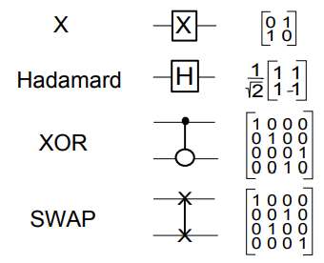
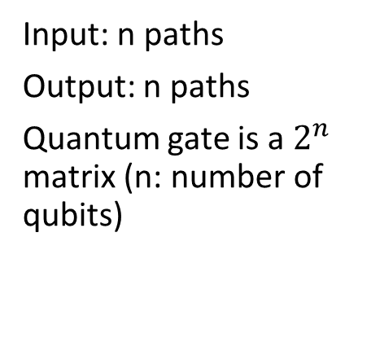
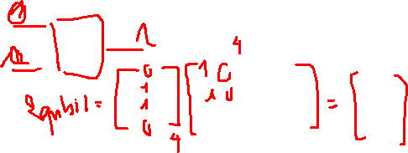
2.2. Quantum gate
Input: n paths
Output: n paths
Quantum gate is a $2^{n}$ matrix (n: number of qubits)

Slide 17
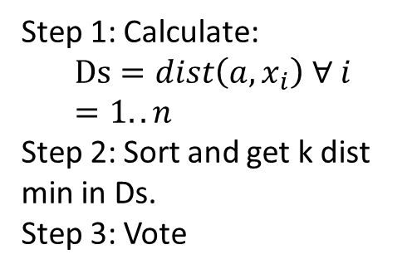
2. KNN version quantum
Step 1: Calculate:
$$Ds=dist\left(a, x_{i}\right) ∀ i=1..n$$
Step 2: Sort and get k dist min in Ds.
Step 3: Vote

Slide 18
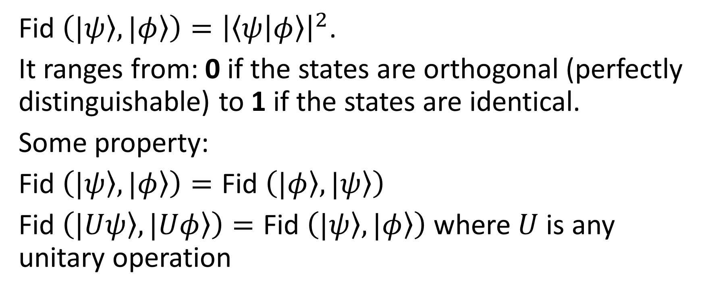
2.1. Similarity between vectors (quantum states)
Fid $\left(\left.|ψ\right\rangle ,\left.|φ\right\rangle \right)={\left|\left\langle ψ | φ\right\rangle \right|}^{2}$.
It ranges from: 0 if the states are orthogonal (perfectly distinguishable) to 1 if the states are identical.
Some property:
Fid $\left(\left.|ψ\right\rangle ,\left.|φ\right\rangle \right)=\text{Fid} \left(\left.|φ\right\rangle ,\left.|ψ\right\rangle \right)$
Fid $\left(\left.|Uψ\right\rangle ,\left.|Uφ\right\rangle \right)=\text{Fid} \left(\left.|ψ\right\rangle ,\left.|φ\right\rangle \right)$ where $U$ is any unitary operation

Slide 19
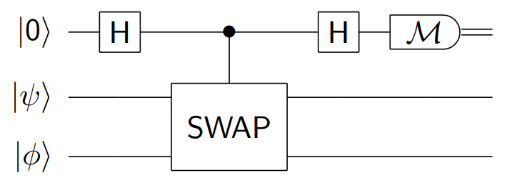
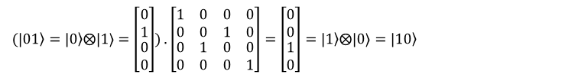
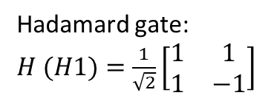
2.2. Control – Swap test
Hadamard gate: $H (H1)=\frac{1}{\sqrt{2}}\left[\begin{matrix}1 & 1 \\ 1 & −1\end{matrix}\right]$
Fredkin gate
$$(\left.|01\right\rangle =\left.|0\right\rangle ⨂\text{|}\text{1}\text{⟩}=\left[\begin{matrix}0 \\ 1 \\ \begin{matrix}0 \\ 0\end{matrix}\end{matrix}\right])\text{ .} \left[\begin{matrix}\begin{matrix}1 & 0 \\ 0 & 0\end{matrix} & \begin{matrix}0 & 0 \\ 1 & 0\end{matrix} \\ \begin{matrix}0 & 1 \\ 0 & 0\end{matrix} & \begin{matrix}0 & 0 \\ 0 & 1\end{matrix}\end{matrix}\right]=\left[\begin{matrix}0 \\ 0 \\ \begin{matrix}1 \\ 0\end{matrix}\end{matrix}\right]=\left.|1\right\rangle ⨂\text{|}\text{0}\text{⟩}=\left.|10\right\rangle$$

Slide 20












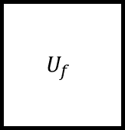
$$|0⟩$$
H
H
$$|ψ⟩$$
$$|φ⟩$$
$$A$$
$$B$$
$$C$$
$$D$$
$$|r_{c}⟩$$
H
H
$$|r_{ψ}⟩$$
$$|r_{φ}⟩$$
$$U_{f}$$
$$|r_{i}⟩$$
$$H^{⊗n}$$

Slide 21
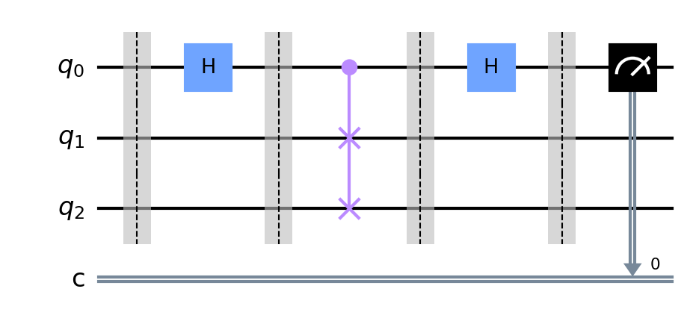




$$A$$
$$B$$
$$C$$
$$D$$

Slide 22
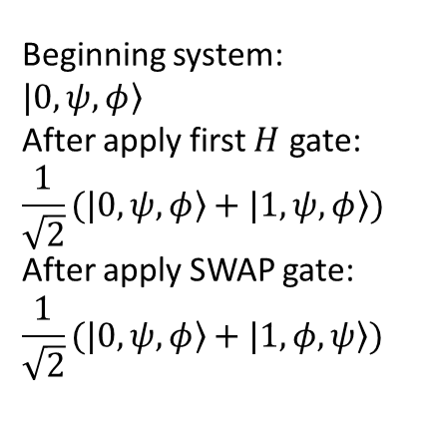
2.2. Control – Swap test
Beginning system:
$$\left.|0,ψ,φ\right\rangle$$
After apply first $H$ gate:
$$\frac{1}{\sqrt{2}}(\left.|0,ψ,φ\right\rangle +\left.|1,ψ,φ\right\rangle )$$
After apply SWAP gate:
$$\frac{1}{\sqrt{2}}(\left.|0,ψ,φ\right\rangle +\left.|1,φ,ψ\right\rangle )$$

Slide 23
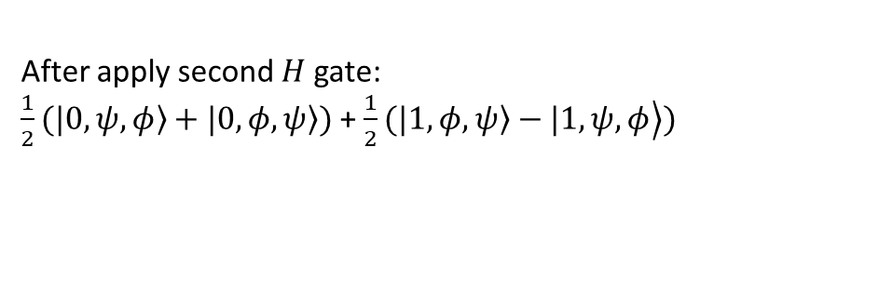
2.2. Control – Swap test
After apply second $H$ gate:
$\frac{1}{2}(\left.|0,ψ,φ\right\rangle +\left.|0,φ,ψ\right\rangle )$ + $\frac{1}{2}(\left.\left.|1,φ,ψ\right\rangle −|1,ψ,φ\right\rangle )$

Slide 24

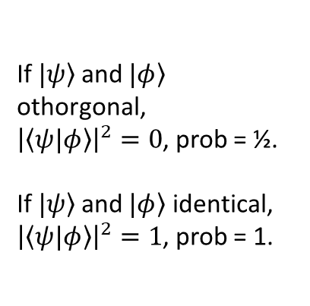
2.3. Result
If $\left.|ψ\right\rangle$ and $\left.|φ\right\rangle$ othorgonal,
${\left|\left\langle ψ|φ\right\rangle \right|}^{2}=0$, prob = ½.
If $\left.|ψ\right\rangle$ and $\left.|φ\right\rangle$ identical,
${\left|\left\langle ψ|φ\right\rangle \right|}^{2}=1$, prob = 1.
After apply measurement $M$ gate:

Slide 25
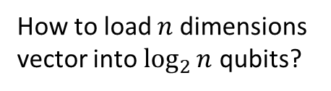
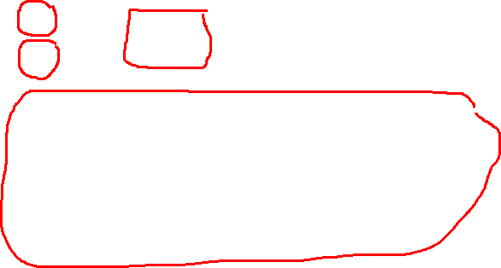
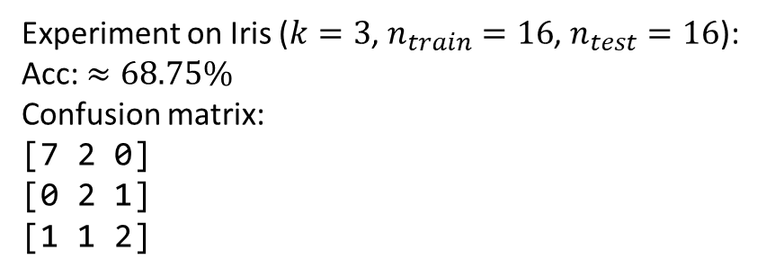
2.4. Bring QKNN to real life
How to load large classical database into circuit
How to load $n$ dimensions vector into $\log_{2}{n}$ qubits?
Experiment on Iris ($k=3$, $n_{train}=16$, $n_{test}=16$):
Acc: $≈68.75\%$
Confusion matrix:
[7 2 0]
[0 2 1]
[1 1 2]

Slide 26
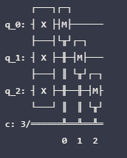
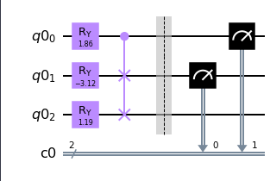


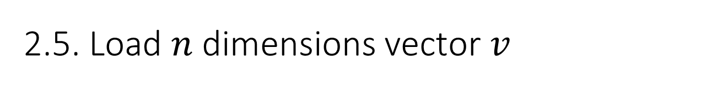


2.5. Load $n$ dimensions vector $v$
Use a set of $R_{φ}$ and Fredkin-gate
[ 0.00617277 -0.59928878 0.66390817 0.44725919]
Vector $|111⟩$
or [0 0 0 0 0 0 0 1]
Common case: $v$ is a real vector
Simplest case: $v$ is a binary vector

Slide 27

Way to train QKNN:
Combine classical and quantum
Quantum computer only calculate each 2 vector and return results to classical computer
Classical computer sorts all distances and do major vote

Slide 28
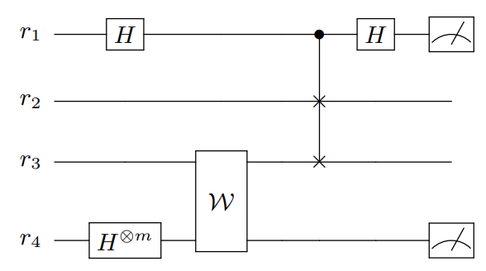

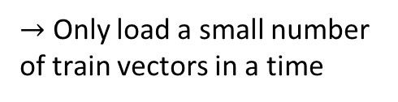

2.4.1. Load large classical database into circuit
$$|0⟩$$
Load test vector
$→$ Only load a small number of train vectors in a time
Load train vector
Convert database to an oracle (black box)
Load $m$ vector

Slide 29
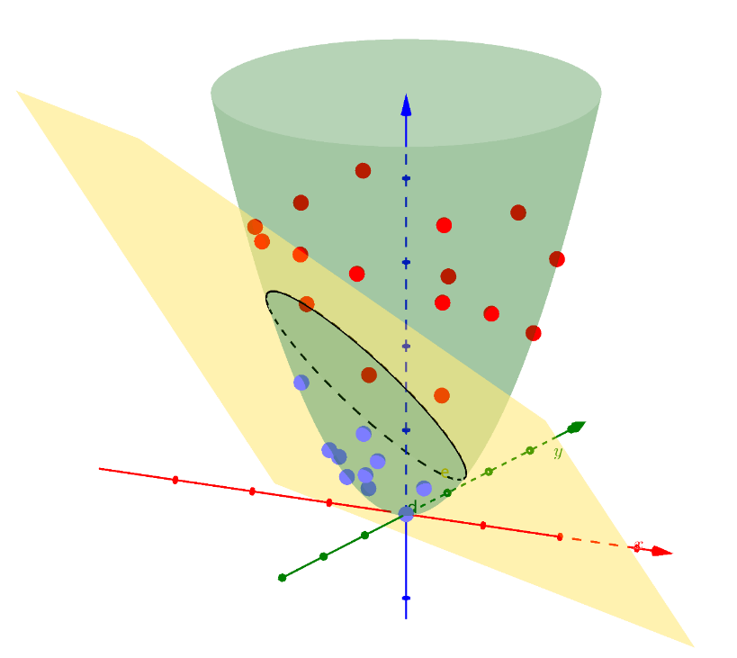
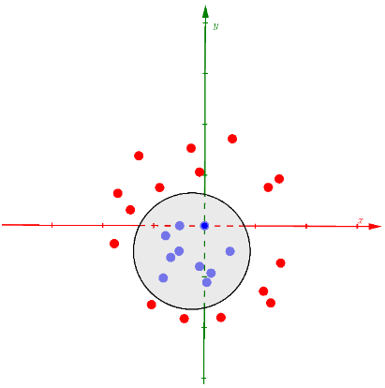


3. SVM version quantum
$$Φ()$$
$$\{\vec{x_{i}},y_{i}:\vec{x_{i}}∈R^{N},y_{i}∈{\left\{−1,1\right\}}_{i}\}=1…M$$

Slide 30
3.1. Steps
1. Mapping data non-linear to quantum state
2. (2.1) Use a variational circuit to generate hyperplane
(2.2) Use the quantum computer to estimate the kernel function of the quantum feature space directly

Slide 31

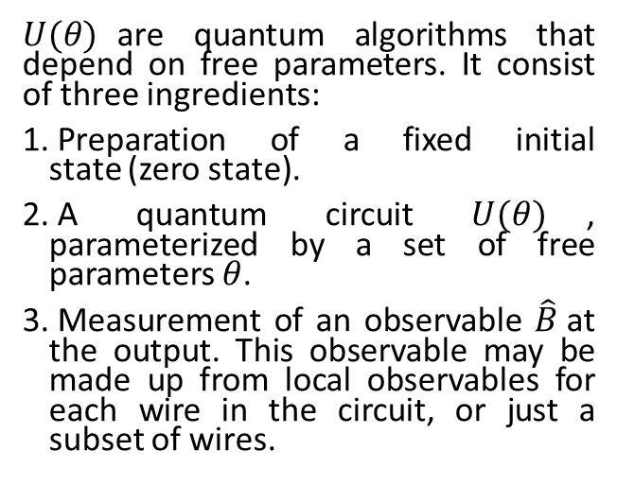

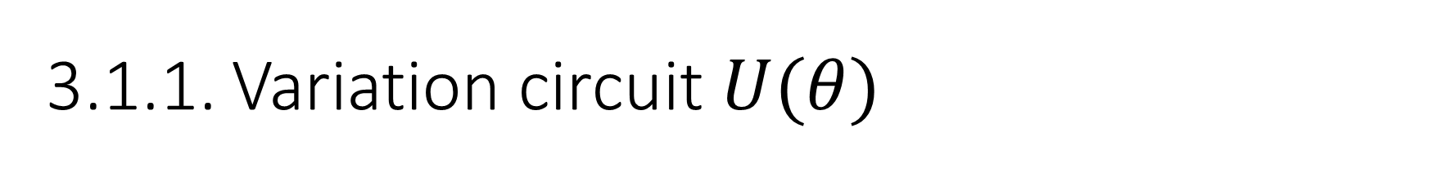
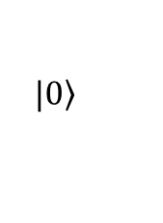
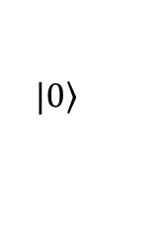

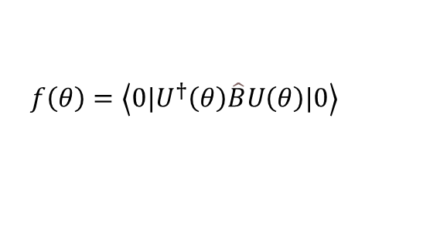

3.1.1. Variation circuit $U(θ)$
$U(θ)$are quantum algorithms that depend on free parameters. It consist of three ingredients:
Preparation of a fixed initial state (zero state).
A quantum circuit $U(θ)$, parameterized by a set of free parameters $θ$.
Measurement of an observable $\hat{B}$at the output. This observable may be made up from local observables for each wire in the circuit, or just a subset of wires.
$$f\left(θ\right)=\left\langle 0\left.|U^{†}\left(θ\right)\hat{B}U\left(θ\right)|0\right\rangle \right.$$
$$\left.|0\right\rangle$$
$$f\left(θ\right)$$
$$\left.|0\right\rangle$$
$$\left(θ\right)$$
$$tuned$$
$$cost$$

Slide 32
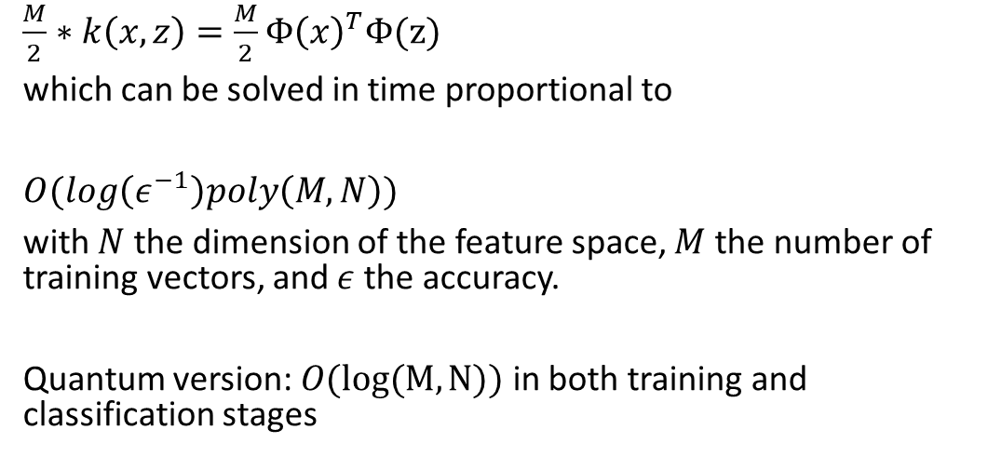
3.1.2. Problem when calculate kernel trick
$\frac{M}{2}∗k\left(x,z\right)=\frac{M}{2}Φ{\left(x\right)}^{T}Φ(z)$
which can be solved in time proportional to
$O(log\left(ε^{−1}\right)poly\left(M,N\right))$
with $N$ the dimension of the feature space, $M$ the number of training vectors, and $ε$ the accuracy.
Quantum version: $O(log⁡(M,N))$ in both training and classification stages

Slide 33

3.2. Quantum advantage
$$O(log⁡(M,N))$$
$$\text{Fast} \text{quantum} \text{evaluation} \text{of} \text{inner} \text{products}$$
Re-express the SVM as an approximate least-squares problem that allows for a quantum solution with the matrix inversion algorithm

Slide 34
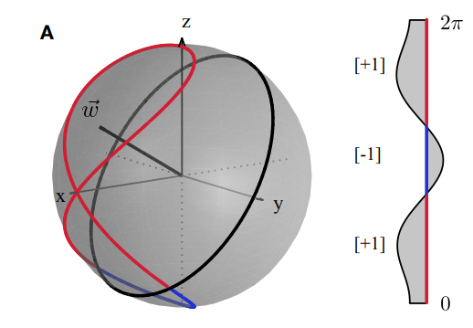
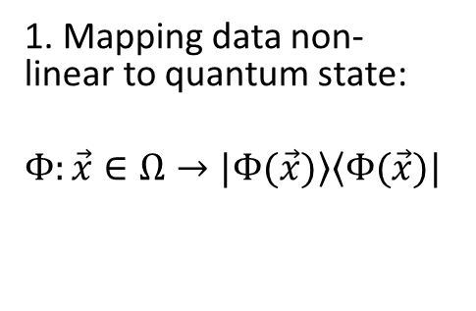


3.3. Mapping
Non-linear feature map
1. Mapping data non-linear to quantum state:
$$Φ:\vec{x}∈Ω→\left.|Φ(\vec{x})\right\rangle \left\langle Φ(\vec{x})|\right.$$
Quantum phase gate
S
$$=\left[\begin{matrix}1 & 0 \\ 0 & e^{iφ}\end{matrix}\right]$$
$$\left.|a\right\rangle →e^{\frac{iπ}{2}a}\left.|a\right\rangle$$
Bloch sphere
classical dataset in the interval Ω = (0, 2π] with binary labels

